Slide 1
An Episodic Action-Adventure Role-Playing Video Game

Slide 2
Synopsis
The Solar Republic, once the pinnacle of civilization, and ruled over a quarter of the known galaxy, is now in chaos. Over a century of political instability and hyperinflation has caused widespread rebellions across the frontiers of the republic. When the renegade general, Joseph Krige, took controlled of Earth, the republic’s capital, the Solar Republic collapsed and dissolved into warring factions vying for power. As the republic crumbles, the alien nations are preying on this opportunity to gain fresh lands for their people. Only the most inspired leadership can save the once mighty nation from calamity.

Slide 3
Platforms

Slide 4
Business Model
Kickstarter
Digital Download
Physical Copies

Slide 5
An Episodic Action-Adventure Role-Playing Video Game

Slide 6
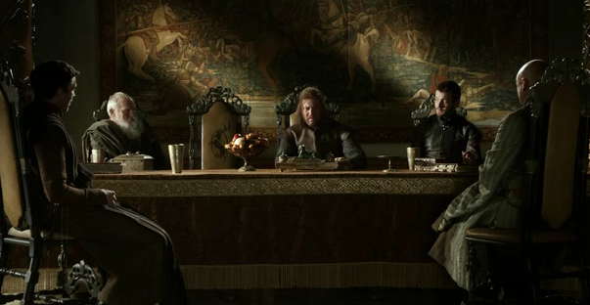
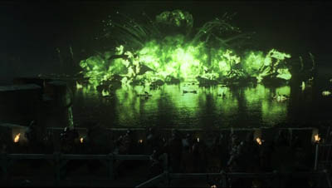
Structure
Season Start
Story Focused
Season End
Combat Focused

Slide 7
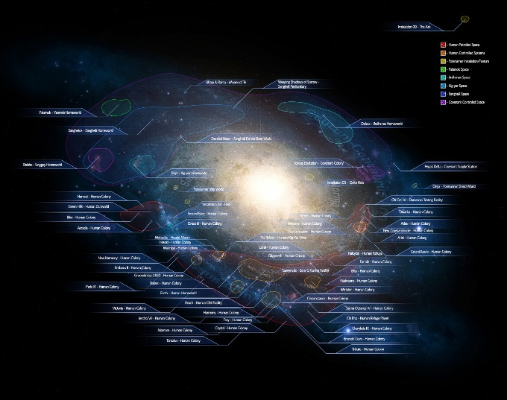
Gameplay
First-Person Shooter
Multiple playable characters
Dialogue list instead of dialogue wheel
Galaxy Map

Slide 8
Galaxy Map
Core Armies
Minor Armies
Resources
Rare Earth
Fossil Fuel

Slide 9
Target Audience
The game’s target audience are males between age of 18 -40 living in Europe and North America.
1.2 Billions
576 Millions
328 Millions

Slide 10
Rating

